Slide 1


Ultimate Rock Paper Scissors Lizard Spock Challenge Game
V.Dilli Prakash Reddy
Guided By
Dr. Jayasakthi Velmurgan K
CSA0912
JAVA PROGRAMMING
192211768

Slide 2


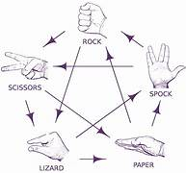
Abstract
To create an enhanced version of the classic Rock Paper Scissors game with additional elements: Lizard and Spock.
Include five choices: Rock, Paper, Scissors, Lizard, Spock.
Each player selects one of the five options.
A fully functional and engaging game that extends the classic Rock Paper Scissors to include Lizard and Spock.

Slide 3
Introduction
The classic game of Rock Paper Scissors has been a popular and simple hand game played for generations.
To provide a fun and competitive gaming experience for users of all ages.
Offers more complexity and strategy compared to the traditional game.

Slide 4
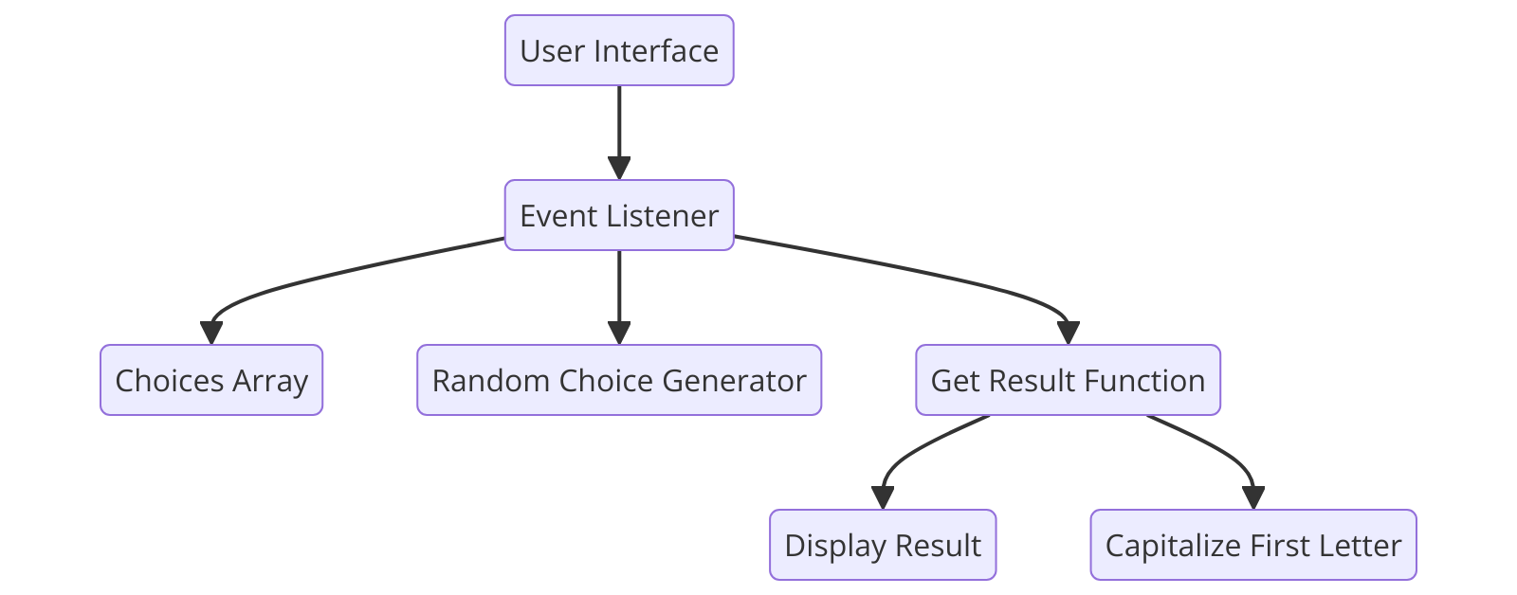
Architecture Diagram
The architecture diagram provides a high-level overview of the various components and their interactions in the game. This diagram is essential for understanding the structure and flow of the application.
This is where users interact with the game. It includes buttons for each choice (rock, paper, scissors, lizard, spock) that users can click to play the game.

Slide 5
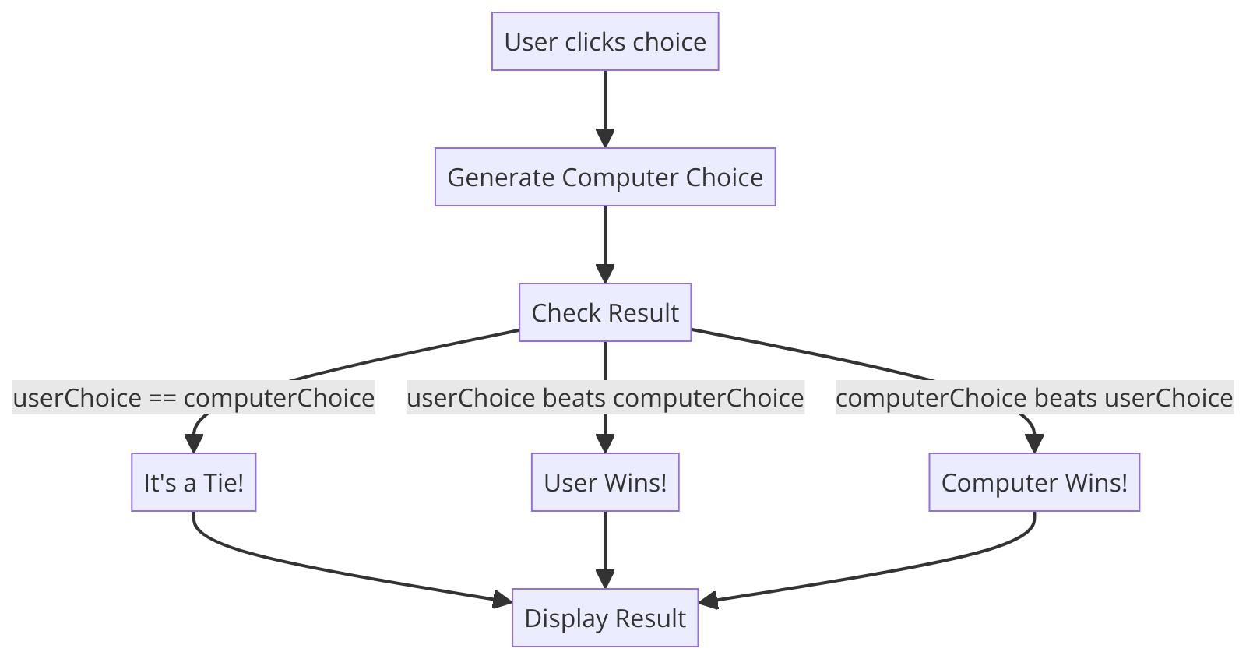
Flow Chart
The flowchart illustrates the logical flow of the game, detailing the steps taken from the user’s interaction to the display of the game result.
The Game class is central to the game logic, interacting with both the Choice and ResultSection classes to manage user input and display results.

Slide 6
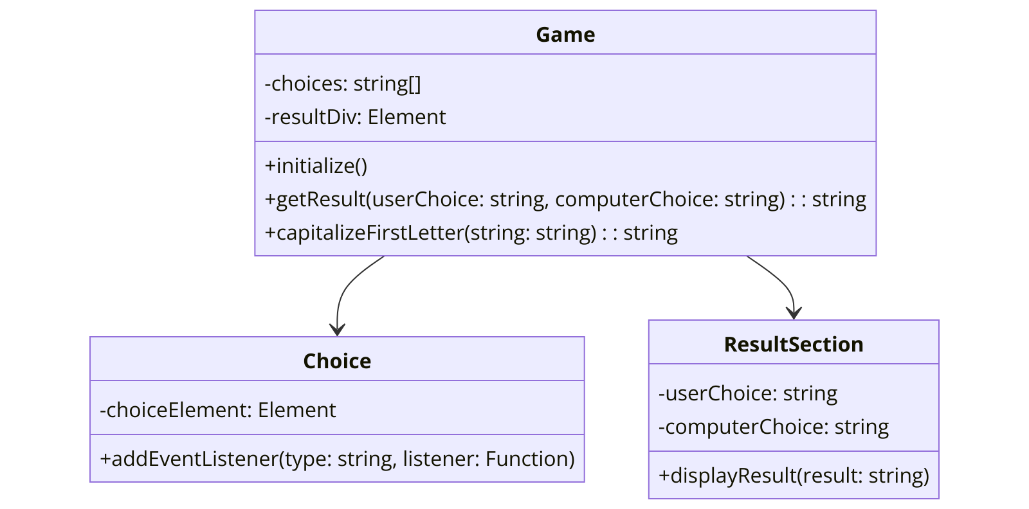
Class Diagram
The UML class diagram for the "Rock, Paper, Scissors, Lizard, Spock" game provides a structured overview of the classes involved in the game, their attributes, methods, and the relationships between these classes. This diagram is critical for understanding the object-oriented design and how various components of the game interact with each other.

Slide 7
UML Chart
The UML class diagram provides a detailed view of the classes involved in the game, their attributes, methods, and relationships.
The Game class is central to the game logic, interacting with both the Choice and ResultSection classes to manage user input and display results.

Slide 8
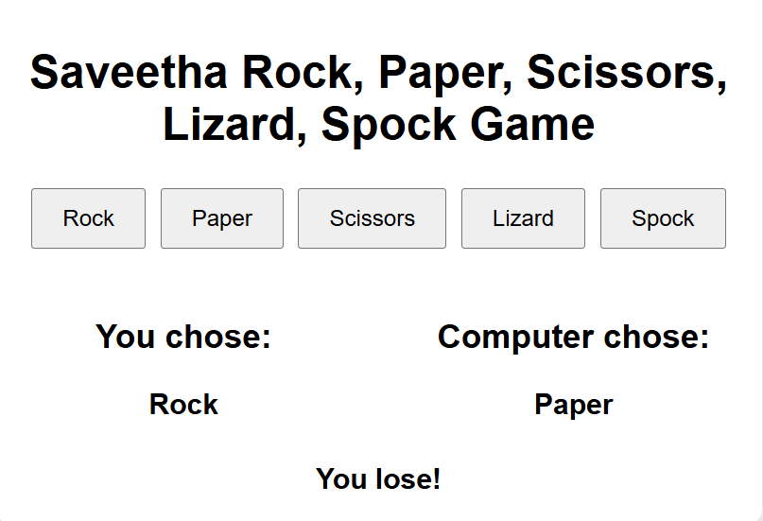

Result Screenshot
while we choose a Rock

Slide 9
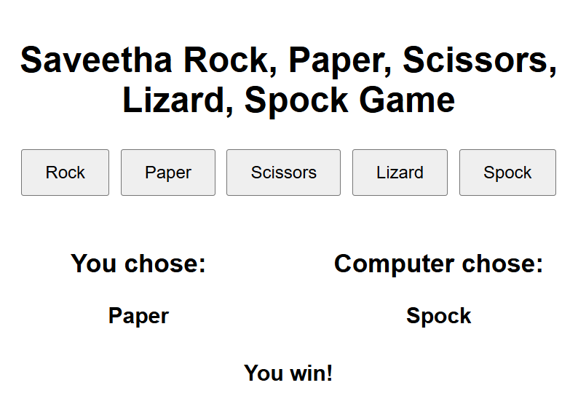
Result Screenshot
while we choosing a paper

Slide 10
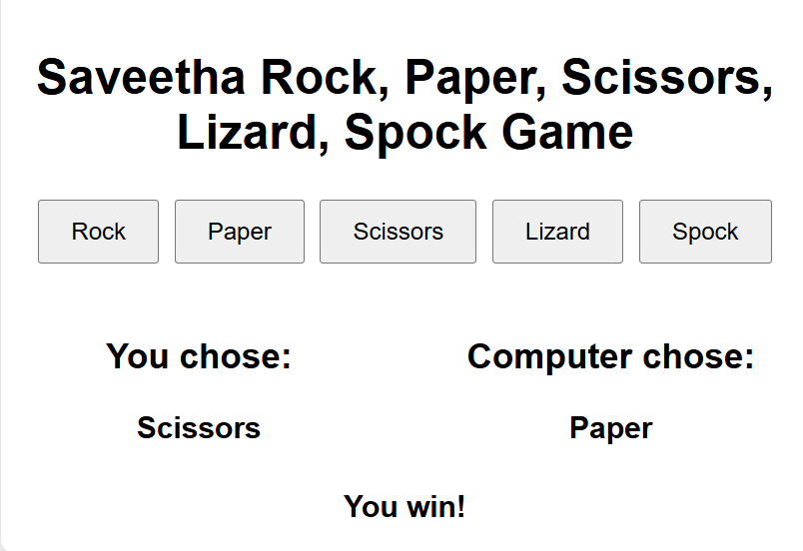
Result Screenshot
While we choosing Scissors

Slide 11
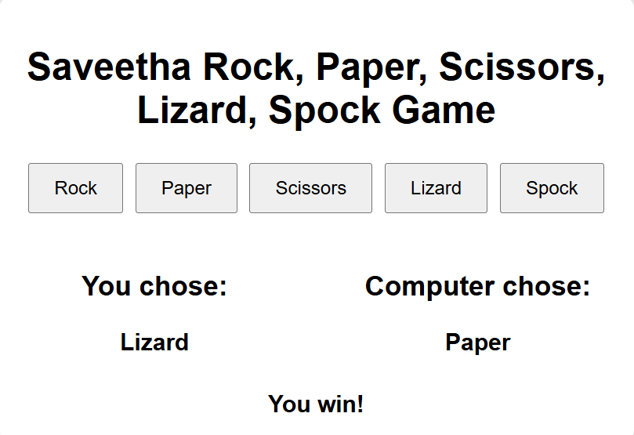
Result Screenshot
While we choosing a Lizard

Slide 12

Result Screenshot
While we choosing a Spock

Slide 13


Conclusion
The "Ultimate Rock Paper Scissors Lizard Spock Challenge Game" successfully revitalizes the classic Rock Paper Scissors game by integrating two additional hand signs: Lizard and Spock. The inclusion of Lizard and Spock not only broadens the range of possible outcomes but also enriches the strategic possibilities for players.

